Slide 1
Automotive Coupon Recommendation System
Minor Project (P-1)
Project No:RP-3
Presented By:-
Yash Bhargava(221B456)
Prathmesh Kale(221B497)
Ritik Prakash(221B498)

Slide 2

Scenario 1
Imagine a scenario:
It’s a Sunday afternoon (1 PM)
You are driving back home from a trip along with your friends
Since it’s 1 PM, you and your friends are likely hungry
Your favorite restaurant is just 5 minutes away in the same direction from where you are
At that exact moment you see a notification pop up in your phone stating you received a coupon for 20% discount at your favorite restaurant
How likely are you to take the offer and avail it?

Slide 3

Scenario 2
Imagine another scenario:
It’s a Monday morning (10 AM)
You are driving to work alone
Since it’s 10 AM, you most likely had your breakfast
At that exact moment you see a notification pop up in your phone stating you received a coupon for 20% discount at a restaurant which is 5 miles always in the opposite direction
How likely are you to take the offer and avail it?

Slide 4






Deep-Dive into the Dataset
This data was collected via a survey on Amazon Mechanical Turk. The survey describes different driving scenarios including the destination, current time, weather, passenger, etc., and then ask the person whether he will accept the coupon if he is the driver.
Target Variable
Day Attributes
Journey Attributes
Y - 1, 0 (whether the coupon is accepted or not)
Weather
Temperature
Time
Destination
Passenger - who are the passengers in the car
Demographics
Propensity To Eat Out
Coupon Attributes
Gender
Age
Marital Status
Has Children
Education
Occupation
Income
Bar - # times goes to a bar every month
Coffee House - # times goes to a coffee house every month
Carry Away - # times gets take away food every month
Restaurant less than 20 - # times goes to a restaurant with an average expense per person of less than $20 every month
Restaurant 20 To 50 - # times goes to a restaurant with an average expense per person of $20 - $50 every month
Coupon – what kind of outlet does the coupon relate to
Expiration – time in which the coupon expires
Time to outlet – amount of time it will take to reach the outlet from the point the notification for coupon is received
Direction – if the outlet is in the same direction of the journey or opposite

Slide 5
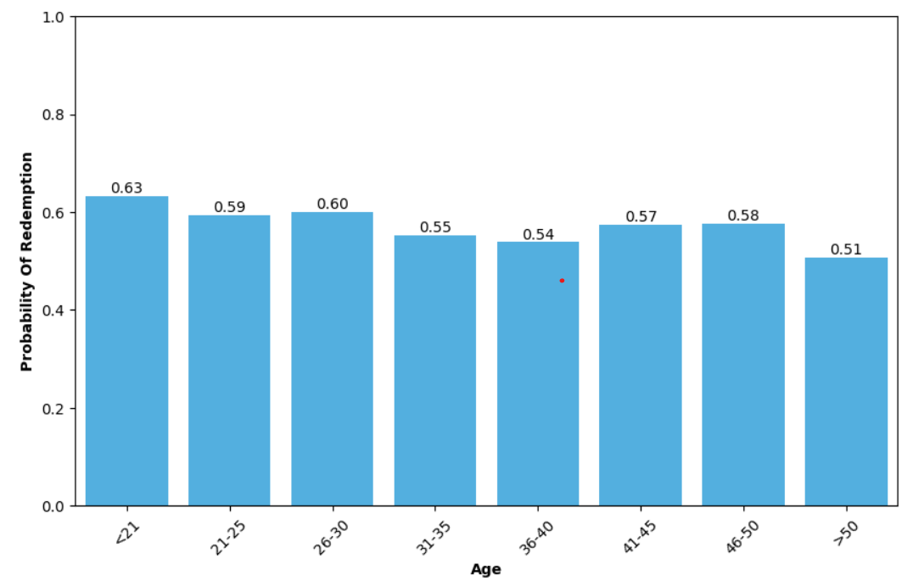
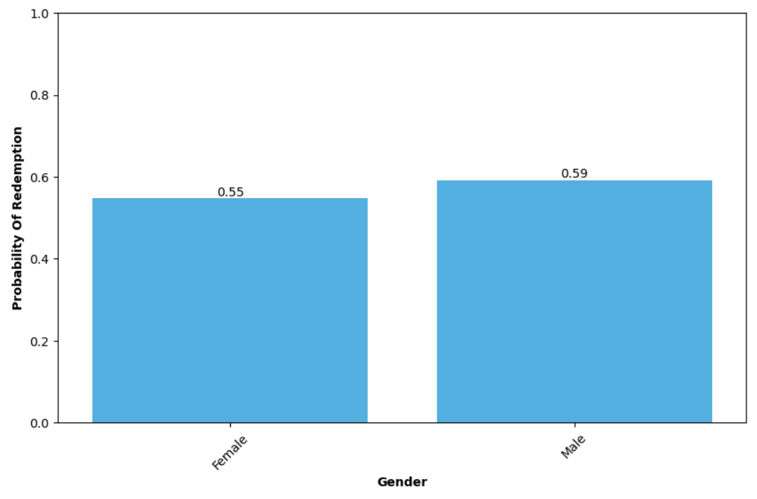
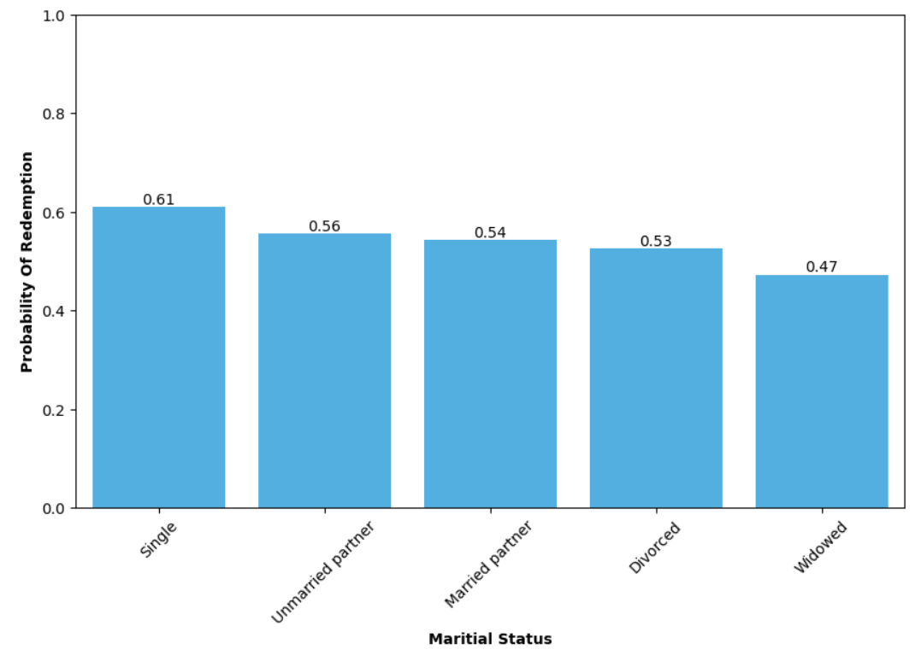
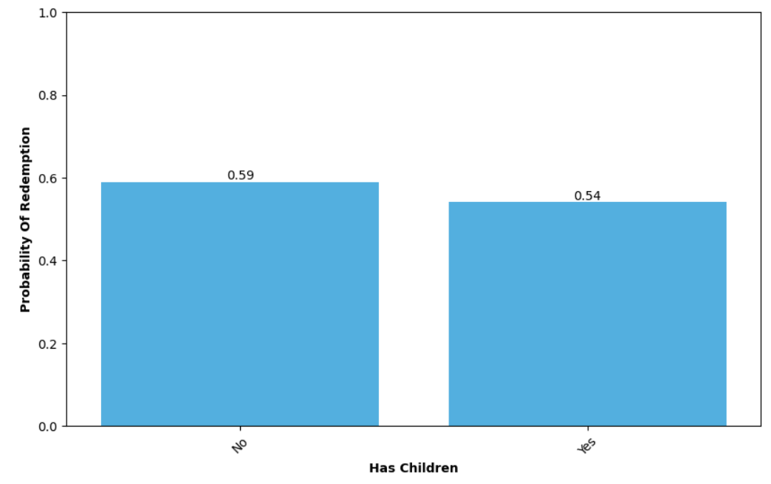
Exploratory Data Analysis – Demographics (1/3)
Age
Gender
Marital Status
Has Children

Slide 6
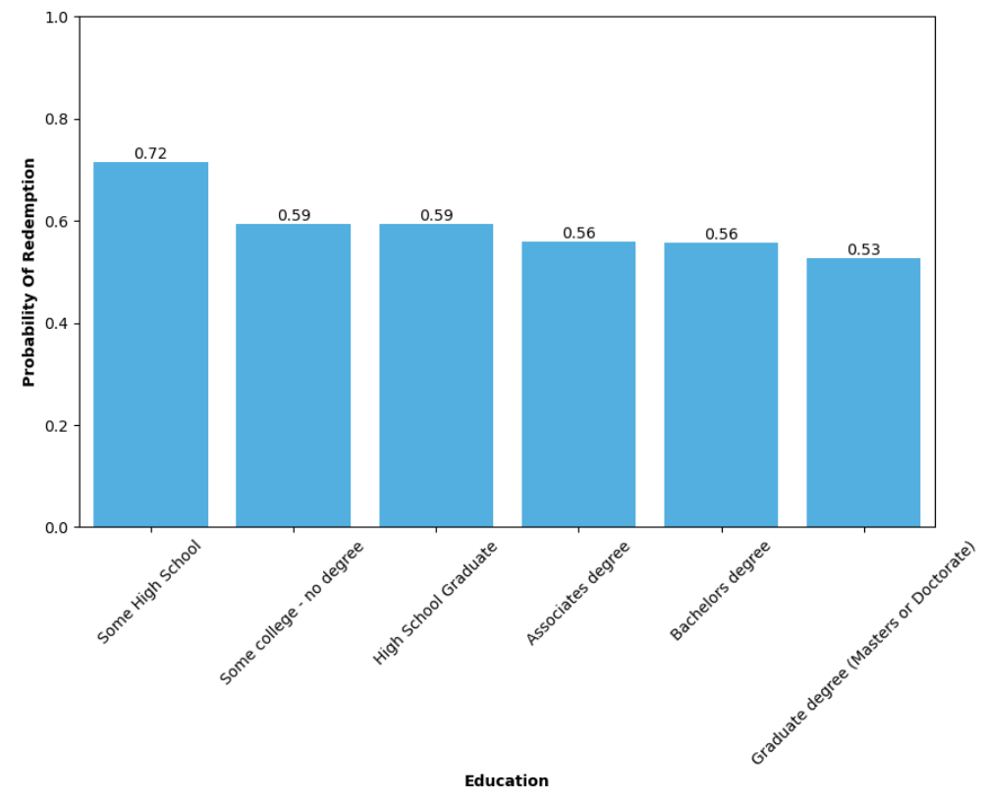
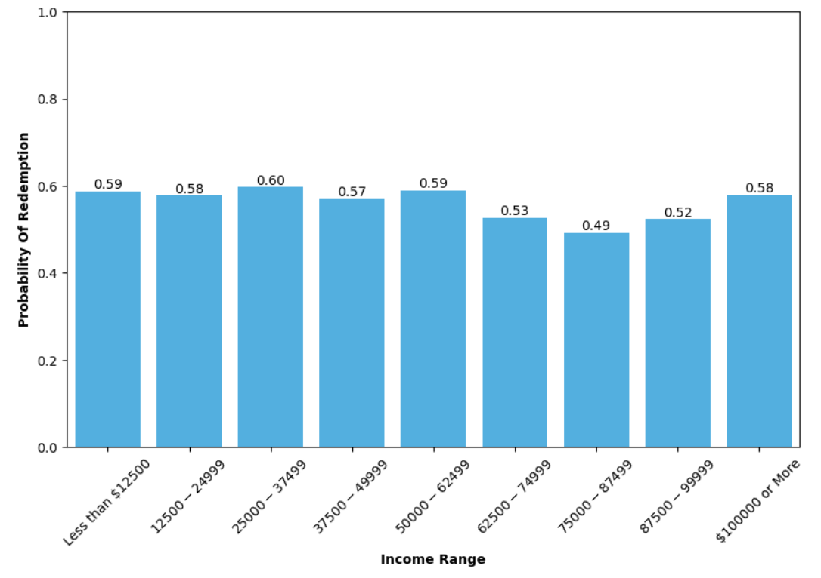
Exploratory Data Analysis – Demographics (2/3)
Education
Income Range

Slide 7
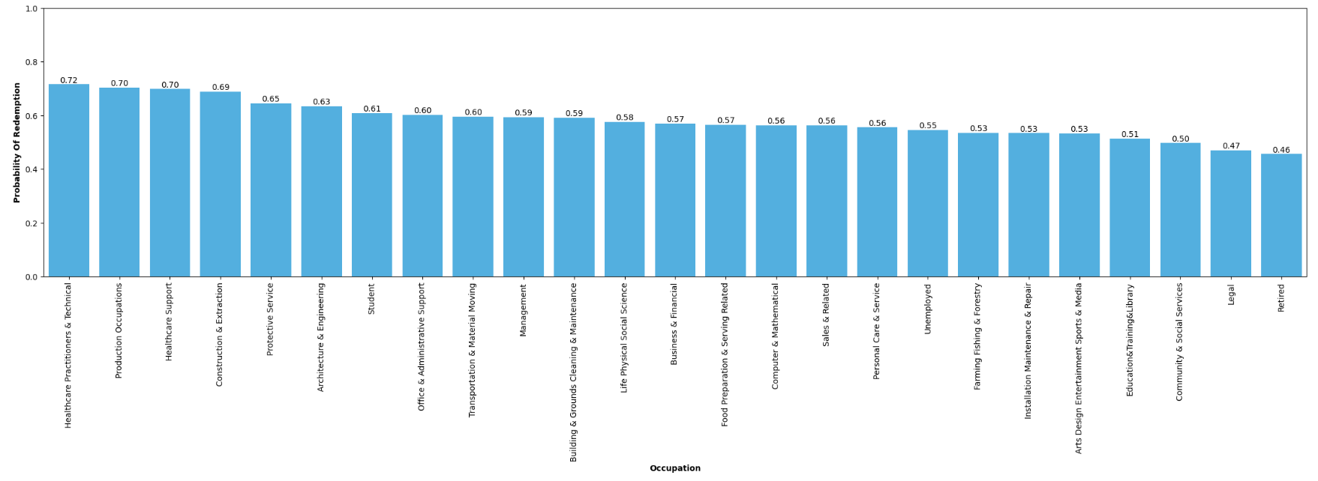
Exploratory Data Analysis – Demographics (3/3)
Occupation

Slide 8
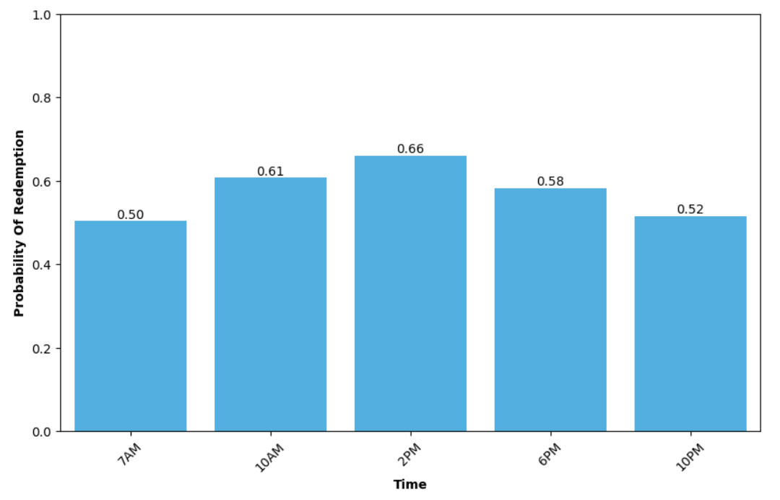
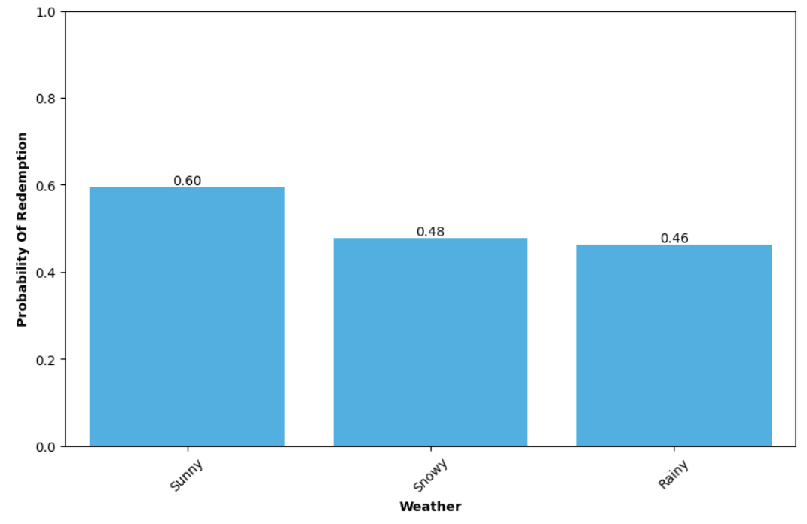
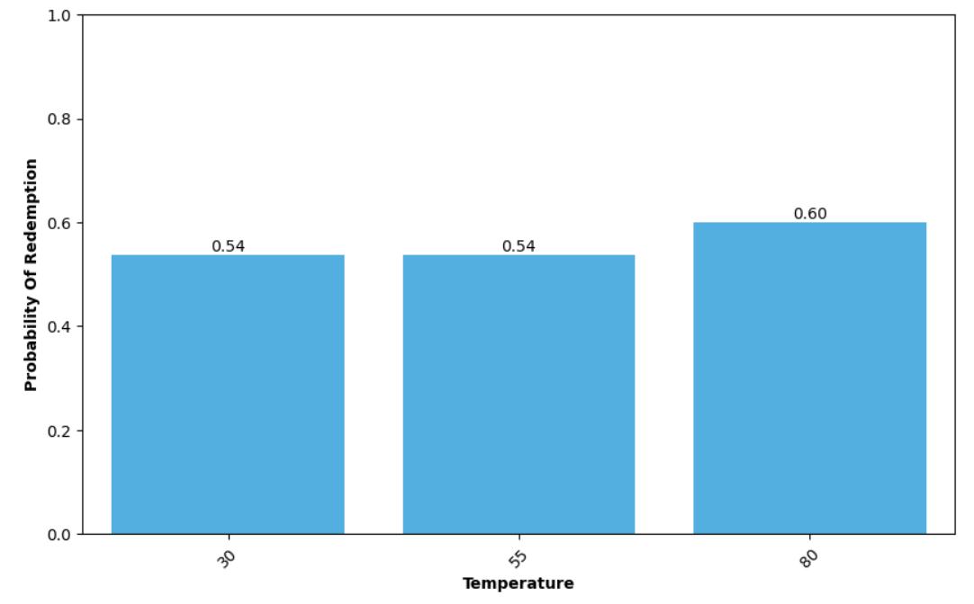
Exploratory Data Analysis – Day Attributes
Time of the day
Weather
Temperature

Slide 9
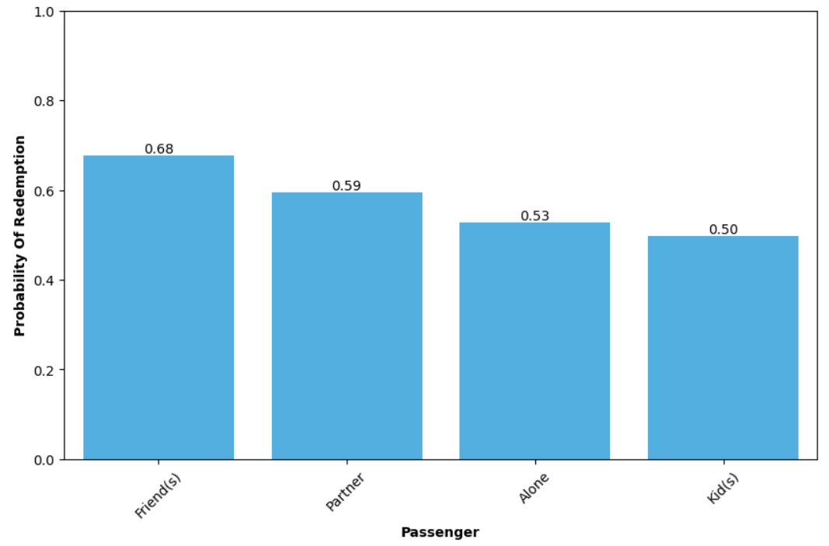
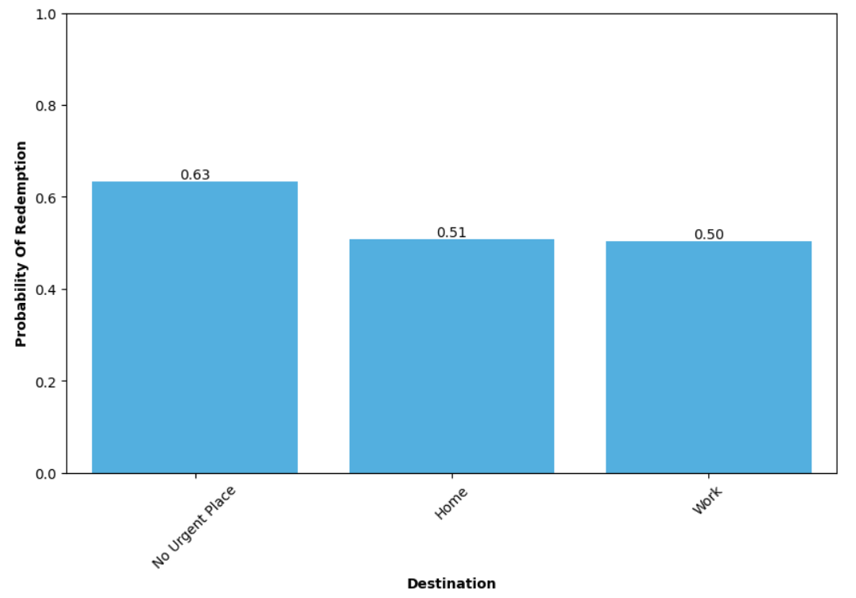
Exploratory Data Analysis – Journey Attributes
Passenger Type
Destination

Slide 10
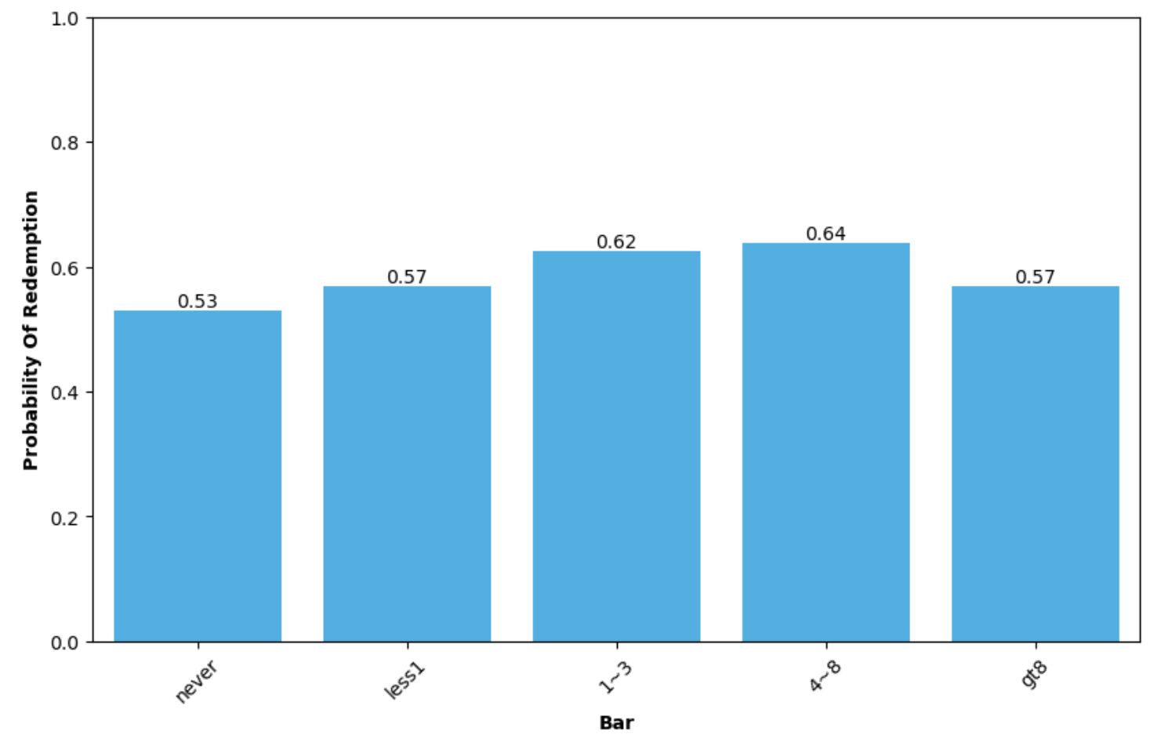
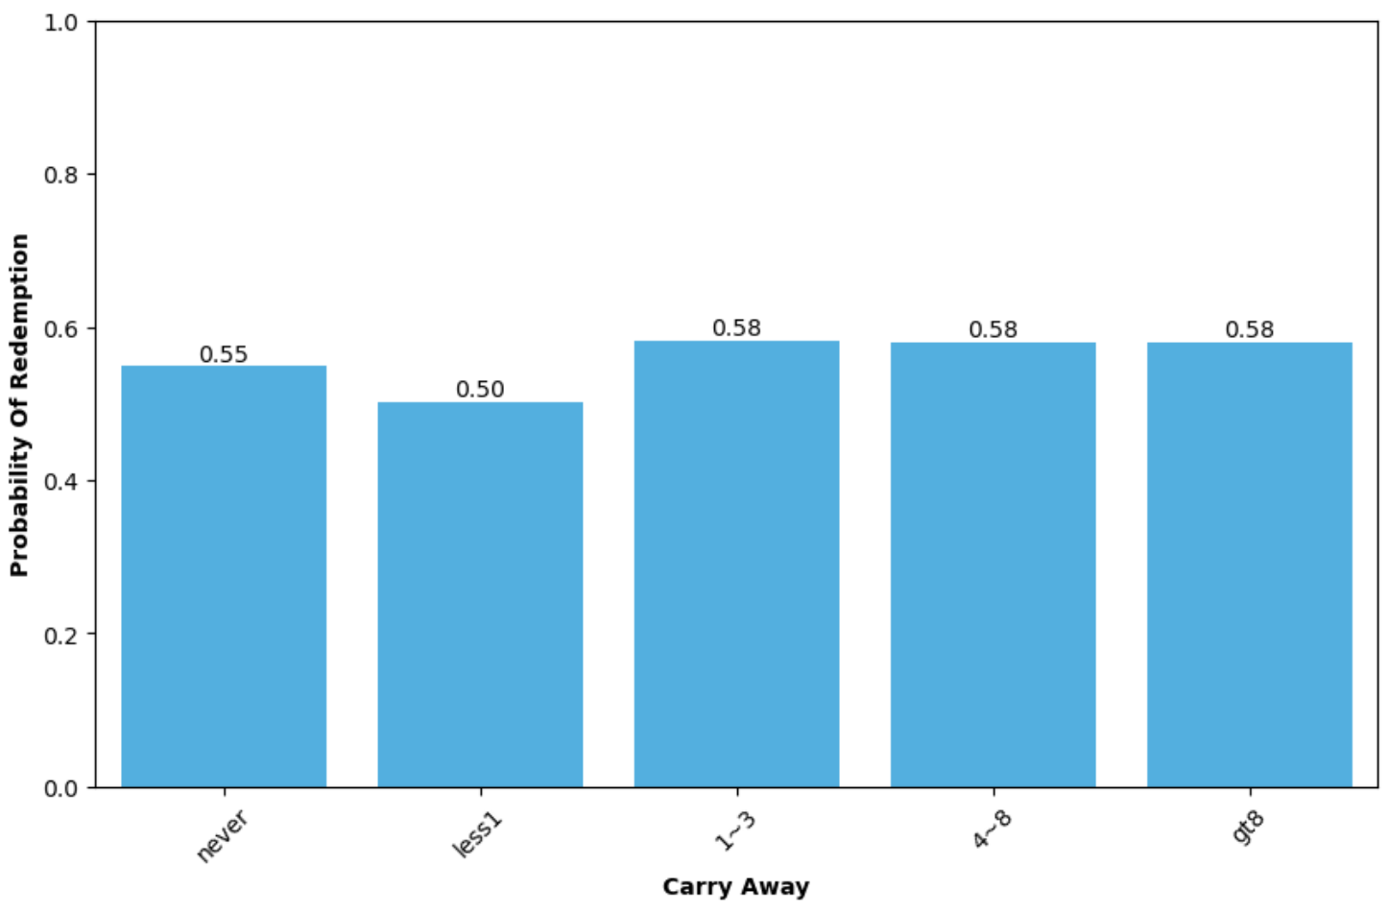
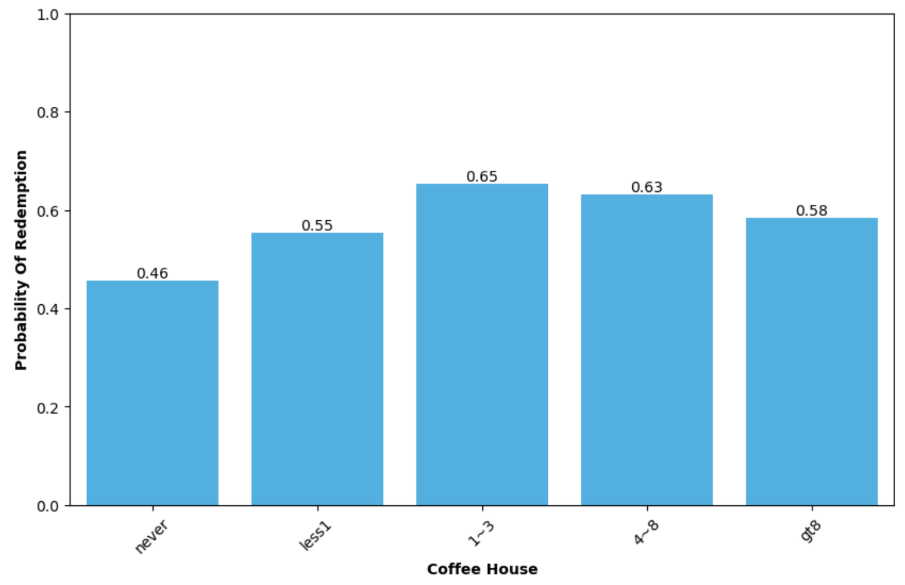
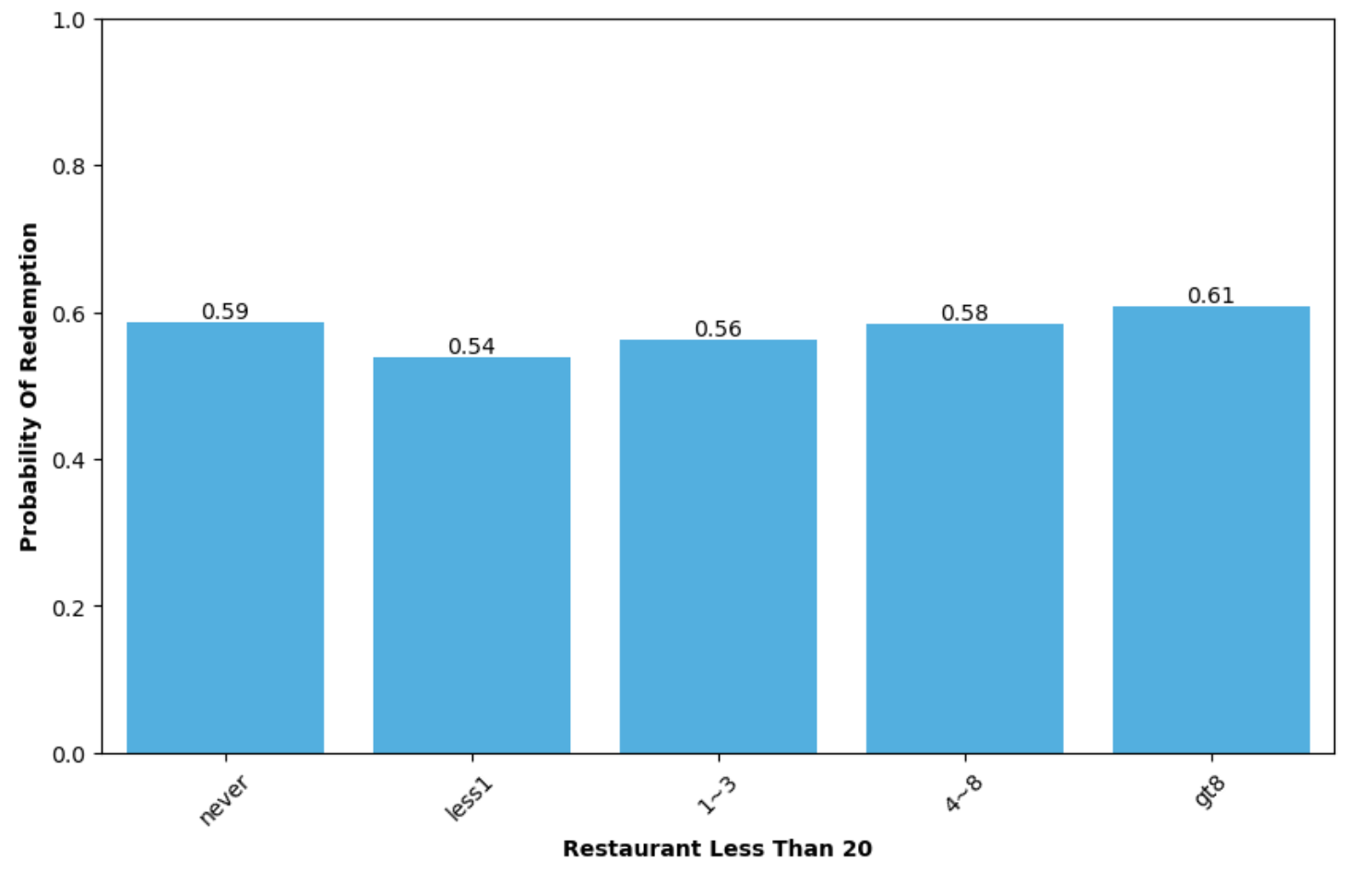
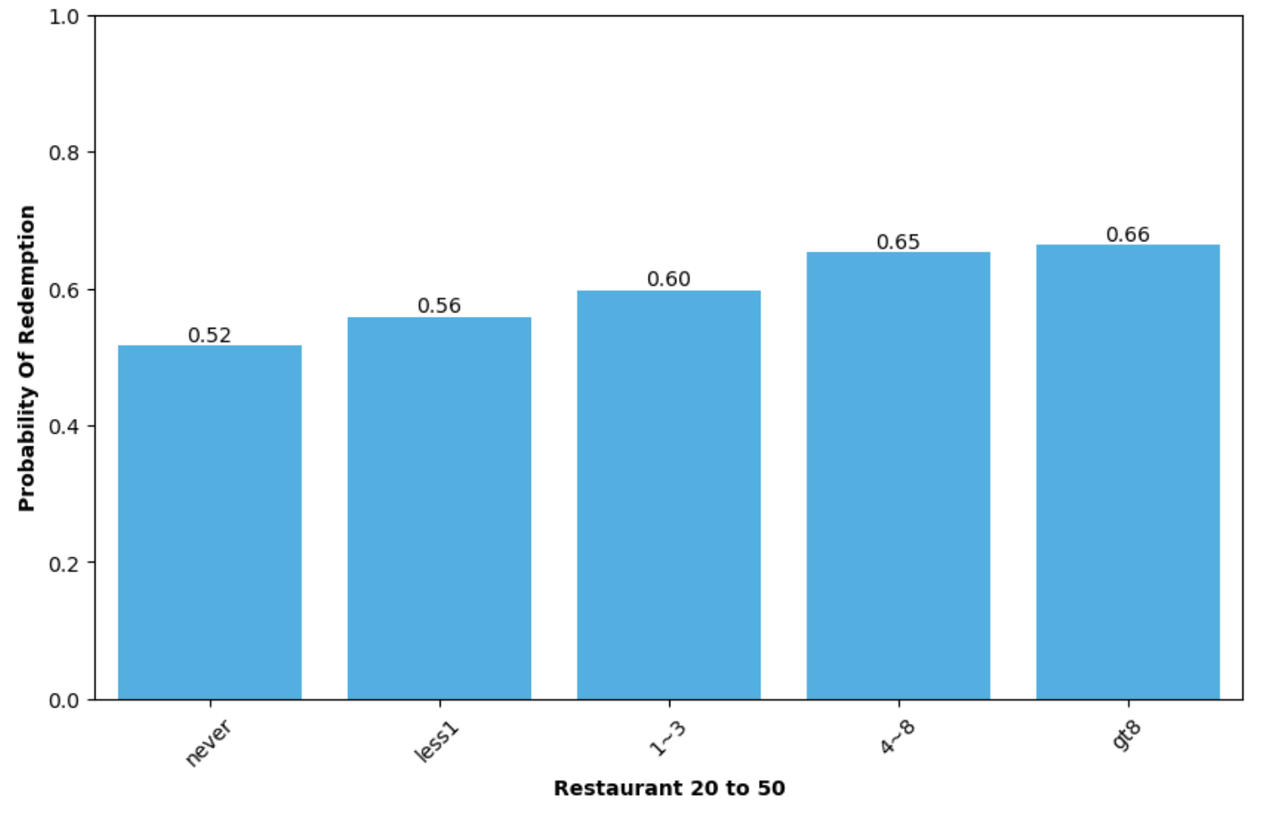
Exploratory Data Analysis – Propensity to eat out
Frequency of going to bar per month
Frequency of carry away per month
Frequency of visiting coffee house per month
Frequency of going to a restaurant with an avg expense per person of <$20 per month
Frequency of going to restaurant with an avg expense per person of $20-$50 per month

Slide 11
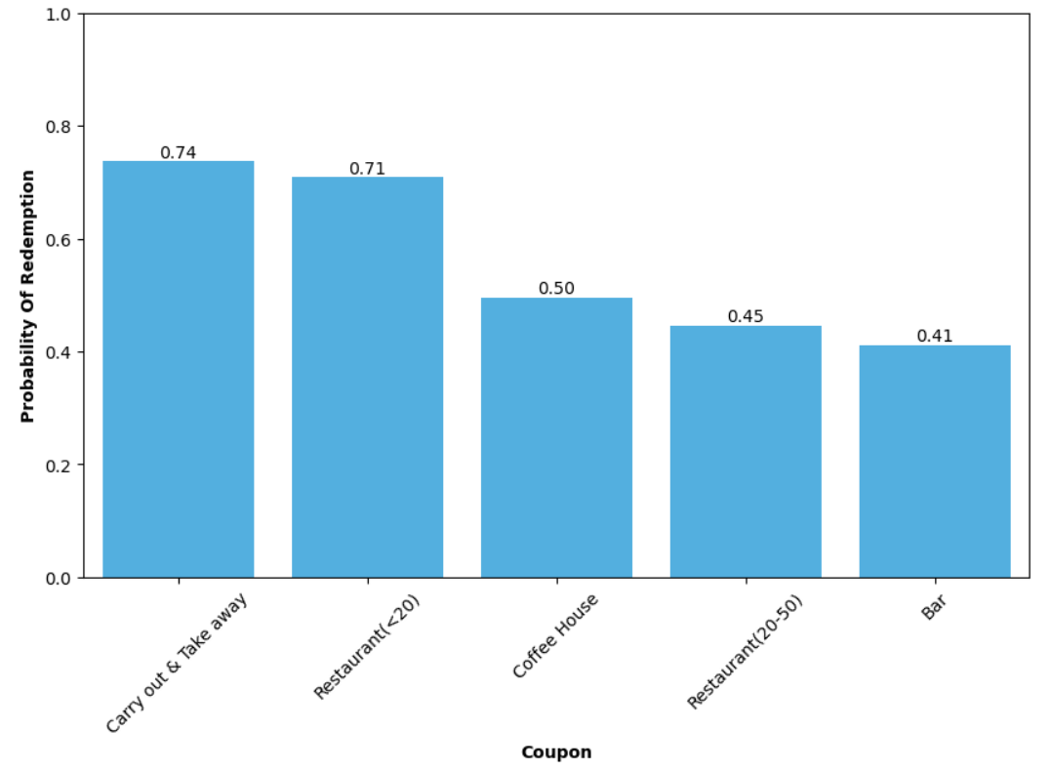
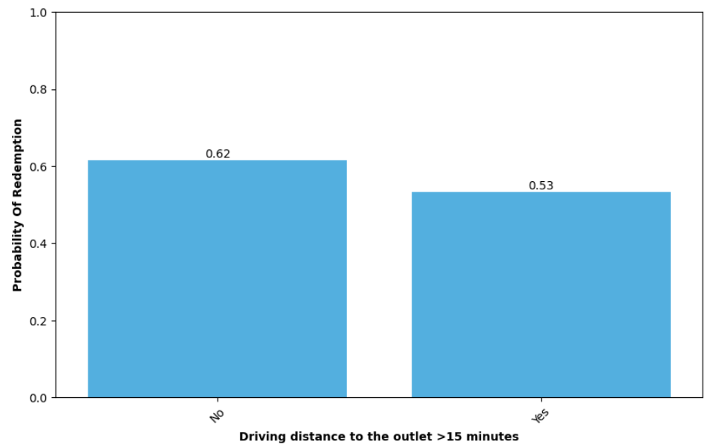
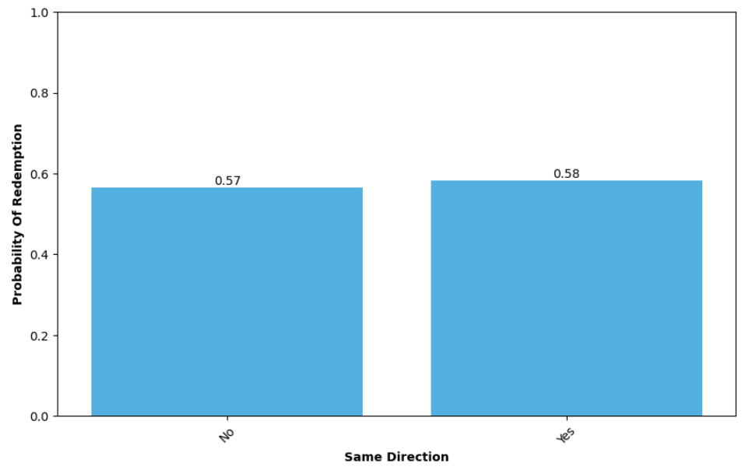
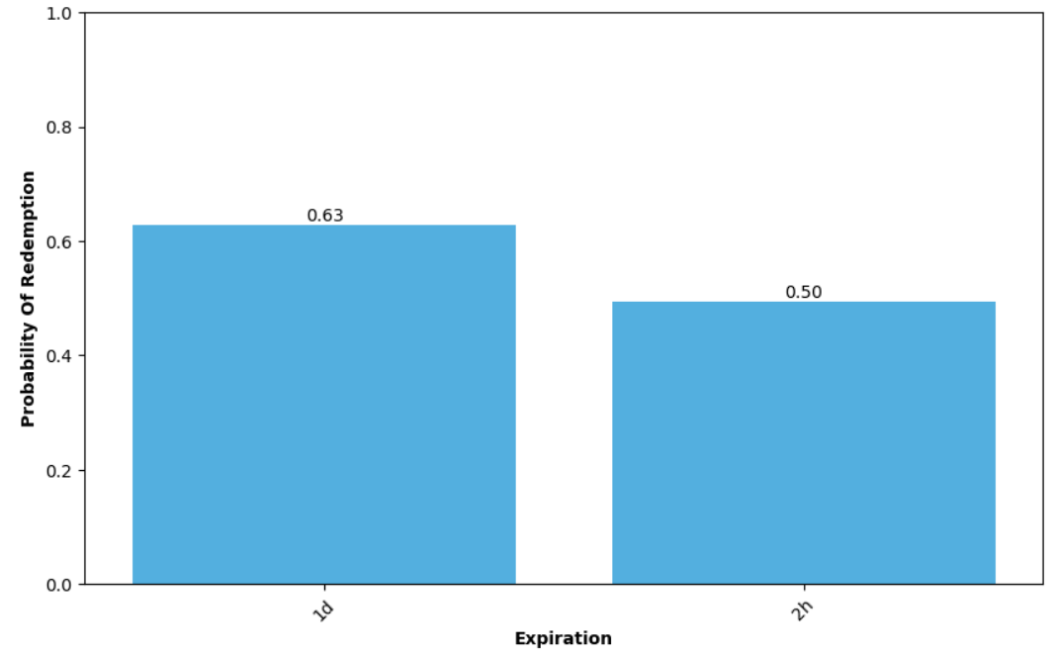
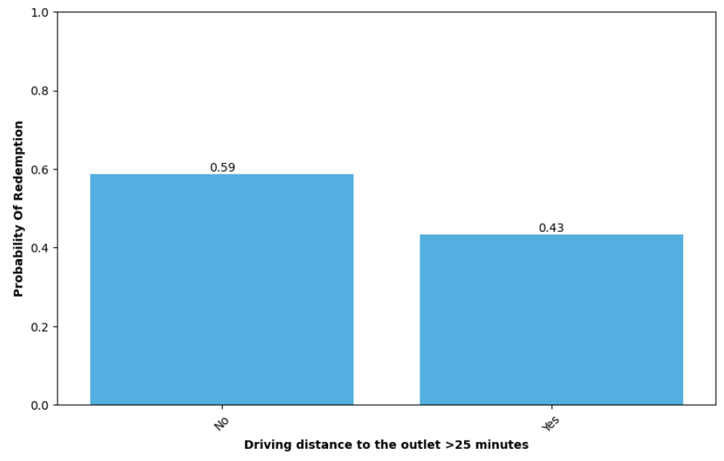
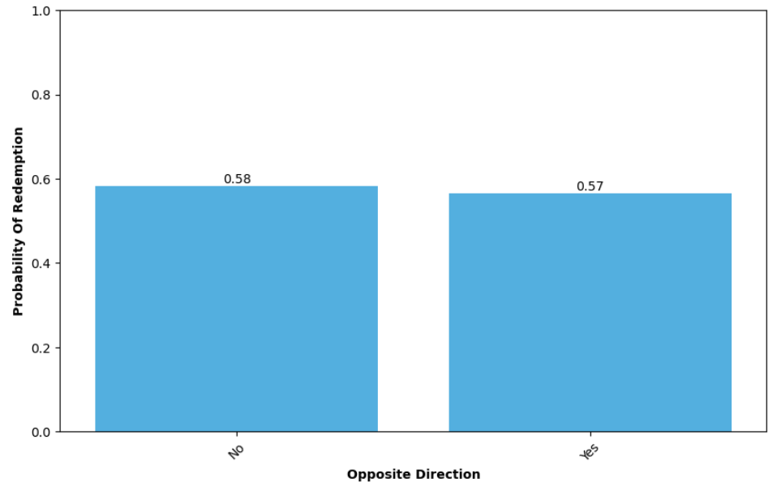
Exploratory Data Analysis – Coupon Attributes
Coupon Type
Driving distance to outlet >15 minutes
Outlet in the same direction as destination
Coupon expiration term
Driving distance to outlet >25 minutes
Outlet in the opposite direction as destination

Slide 12
Modelling Results
Test Accuracy
Naïve Bayes
65%
Bagging
73%
Gradient Boosting
76%
50%
55%
60%
65%
70%
75%
80%
Baseline
57%
Decision Tree
69%
Random Forest
74%
Model Type | Parameters | Precision | Recall | F1 Score
Naïve Bayes Classifier | N/A | 68% | 72% | 70%
Decision Tree | max depth = 10 | 71% | 76% | 74%
Bagging | N/A | 77% | 74% | 75%
Random Forest | # estimators = 27 | 75% | 81% | 78%
Gradient Boosting | # estimators = 500 max depth = 6 | 78% | 80% | 79%

Slide 13
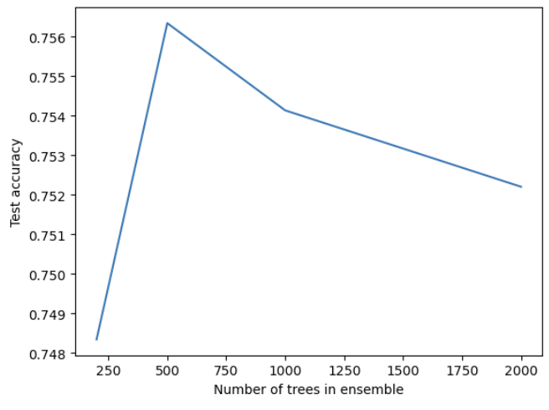
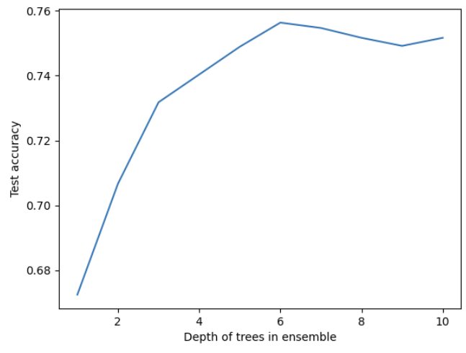
Parameter Tuning– Gradient Boosting Model
Selection of number of trees
Selection of depth of trees
Based on the graphs above, 500 trees and a depth of 6 was chosen as optimum parameters for the gradient boosting model

Slide 14
Feature Importance – Gradient Boosting Model
Raw Importance Scores for top 20 features
Feature Importance Simplified
Factors more likely to influence acceptance | Coupon pertains to take away or a restaurant where per person cost is < $20 Driving distance to the outlet is <15 minutes Not travelling to any urgent place Temperature is moderate Time is in the afternoon Weather is sunny Gender is male Travelling with friends
Factors more likely to influence denial | Coupon pertains to coffee house or a restaurant where per person cost is $20-$50 Person never or rarely goes to a coffee house or bar or gets carry away food Coupon expires within 2 hours Driving distance to the outlet is >15 minutes Early morning or late night

Slide 15
Feature Importance – Decision Trees Model
Raw Importance Scores for top 20 features
Feature Importance Simplified
Factors more likely to influence acceptance | Coupon pertains to take away or a restaurant where per person cost is < $20 Driving distance to the outlet is <15 minutes Not travelling to any urgent place Temperature is moderate Time is in the afternoon Weather is sunny Gender is male Travelling with friends
Factors more likely to influence denial | Coupon pertains to coffee house or a restaurant where per person cost is $20-$50 Person never or rarely goes to a coffee house or bar or gets carry away food Coupon expires within 2 hours Driving distance to the outlet is >15 minutes Early morning or late night

Slide 16
Feature Importance – Random Forest Model
Raw Importance Scores for top 20 features
Feature Importance Simplified
Factors more likely to influence acceptance | Coupon pertains to take away or a restaurant where per person cost is < $20 Driving distance to the outlet is <15 minutes Not travelling to any urgent place Temperature is moderate Time is in the afternoon Weather is sunny Gender is male Travelling with friends
Factors more likely to influence denial | Coupon pertains to coffee house or a restaurant where per person cost is $20-$50 Person never or rarely goes to a coffee house or bar or gets carry away food Coupon expires within 2 hours Driving distance to the outlet is >15 minutes Early morning or late night

Slide 17
Feature Importance – Naïve Bayes Model
Raw Importance Scores for top 20 features
Feature Importance Simplified
Factors more likely to influence acceptance | Coupon pertains to take away or a restaurant where per person cost is < $20 Driving distance to the outlet is <15 minutes Not travelling to any urgent place Temperature is moderate Time is in the afternoon Weather is sunny Gender is male Travelling with friends
Factors more likely to influence denial | Coupon pertains to coffee house or a restaurant where per person cost is $20-$50 Person never or rarely goes to a coffee house or bar or gets carry away food Coupon expires within 2 hours Driving distance to the outlet is >15 minutes Early morning or late night

Slide 18


Recommendations & Challenges
Recommendations
Challenges
Coupon Type - The market agency should focus on coupons pertaining to take out food or restaurants where per person cost is < $20 as they are likely to yield better results
Low Yield - Coupons pertaining to coffee house or a restaurant where per person cost is $20-$50 are likely to yield low results
Journey Attributes - Notifications should be sent when people are travelling with friends and are not going anywhere urgent
Distance from outlet - Notifications should be when the vehicle is within a radius of 15 minutes from the outlet
Day Attributes - Weather and temperature should be moderate, and time should preferably be in the afternoon
Save Efforts - Efforts should be minimized on people who never or rarely go to a coffee house or bar or get carry away food
Data Collection - It is difficult to collect data in such detail like how frequently does the person goes to restaurants or gets take away food
Precision Targeting - High precision is required with respect to sending the notification as there is a golden window of time during which the campaign is effective
Limitations of survey data - The data is based on a survey. Responses cannot be taken at face value. While it does identify the scenarios where the campaign may be most effective, the success rate within those scenarios may not be 100%

Slide 19
Questions?

